Slide 1


Slide 2
Executive Summary: Unveiling the Power of Social Support in Healthcare
Our upcoming Self-Learning Tutorial (SLT) aims to shed light on the often-underestimated impact of social connections—specifically marriage and companionship—on patient health outcomes. This tutorial will provide a practical, step-by-step guide for anyone interested in exploring this vital link.
We'll start by accessing a vast, real-world medical database (MIMIC-III) stored in Google's cloud. From this extensive data, we'll carefully select and extract key information to build a compelling case for how social support influences health. This extracted data will then be prepared for in-depth analysis and compelling visual presentations, allowing us to easily see and understand important trends.
A significant part of the tutorial will involve using advanced text analysis tools to uncover crucial medical details hidden within large volumes of patient notes. This will help us pinpoint specific mentions related to social support and its context in healthcare records.
Ultimately, the SLT will synthesize all findings into clear conclusions, demonstrating the tangible benefits of social connections on health. The entire tutorial is designed to be highly hands-on, providing explicit instructions and code walk-throughs using various data analysis and text processing tools, ensuring that learners can easily follow along and grasp the concepts. Our goal is to empower individuals to understand and articulate the "unseen" yet critical role of social support in promoting better healthcare outcomes.

Slide 3
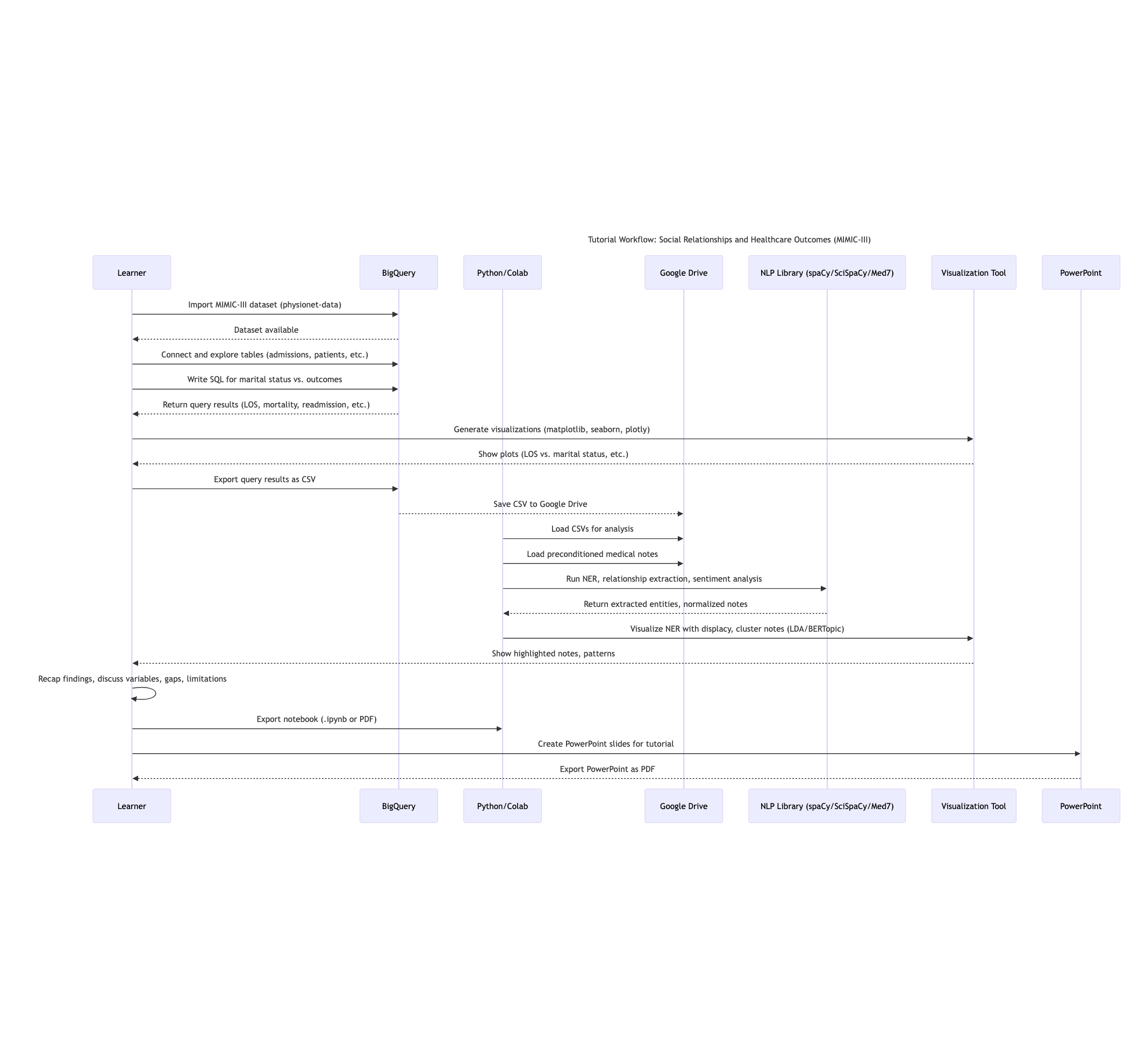
Synthesis and Workflow in Self-Learning Tutorial (SLT)

Slide 4

sequenceDiagram
title Tutorial Workflow: Social Relationships and Healthcare Outcomes (MIMIC-III)
participant User as Learner
participant BigQuery
participant Python as Python/Colab
participant Drive as Google Drive
participant NLP as NLP Library (spaCy/SciSpaCy/Med7)
participant Viz as Visualization Tool
participant PPT as PowerPoint
%% 1. Data Import
User->>BigQuery: Import MIMIC-III dataset (physionet-data)
BigQuery-->>User: Dataset available
%% 2. Data Exploration & SQL Analysis
User->>BigQuery: Connect and explore tables (admissions, patients, etc.)
User->>BigQuery: Write SQL for marital status vs. outcomes
BigQuery-->>User: Return query results (LOS, mortality, readmission, etc.)
%% 3. Visualization of Findings
User->>Viz: Generate visualizations (matplotlib, seaborn, plotly)
Viz-->>User: Show plots (LOS vs. marital status, etc.)
%% 4. Data Export & Python Analysis
User->>BigQuery: Export query results as CSV
BigQuery-->>Drive: Save CSV to Google Drive
Python->>Drive: Load CSVs for analysis
%% 5. NLP with Medical Notes
Python->>Drive: Load preconditioned medical notes
Python->>NLP: Run NER, relationship extraction, sentiment analysis
NLP-->>Python: Return extracted entities, normalized notes
%% 6. Highlight Key Notes
Python->>Viz: Visualize NER with displacy, cluster notes (LDA/BERTopic)
Viz-->>User: Show highlighted notes, patterns
%% 7. Synthesis & Recap
User->>User: Recap findings, discuss variables, gaps, limitations
%% 8. Exportable Output
User->>Python: Export notebook (.ipynb or PDF)
%% 9. Create PowerPoint & Export as PDF
User->>PPT: Create PowerPoint slides for tutorial
PPT-->>User: Export PowerPoint as PDF
Mermaid https://mermaid.live/
Synthesis and Workflow in Self-Learning Tutorial (SLT) UML Code

Slide 5

Tutorial Goal Learners will:
Understand how social relationships (like marriage or companionship) correlate with healthcare outcomes.
Gain hands-on experience querying MIMIC-III in BigQuery Learn Clean, Tokenize and Lemmatization, NER
Analyze structured data and medical notes using Python, Pandas, NLP (spaCy/medSpaCy/SciSpaCy/Med7), and visualization tools.
Learn to normalize, visualize, and interpret clinical data with a health policy/public health lens.

Slide 6

Tools/Tech Stack
BigQuery + SQL
Pandas / NumPy
Seaborn / Matplotlib / Plotly
spaCy / SciSpaCy / Med7
MIMIC III
Google Drive integration
Colab

Slide 7
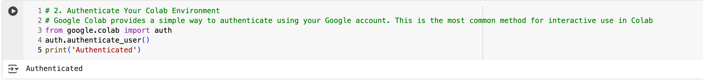
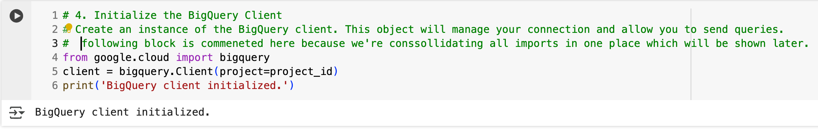
Collab to Bigquery
BigQuery Integration and Data Prep
Connect to BigQuery
Introduce key MIMIC-III tables: admissions, patients, diagnoses_icd, chartevents, noteevents, etc.
Write SQLs to explore:
Marital status vs. outcomes
Length of stay, readmission, mortality, etc.
Compare outcomes across married vs. single vs. widowed/divorced patients

Slide 8
Mortality Counts and Average Age at Death by Marital Status

Slide 9
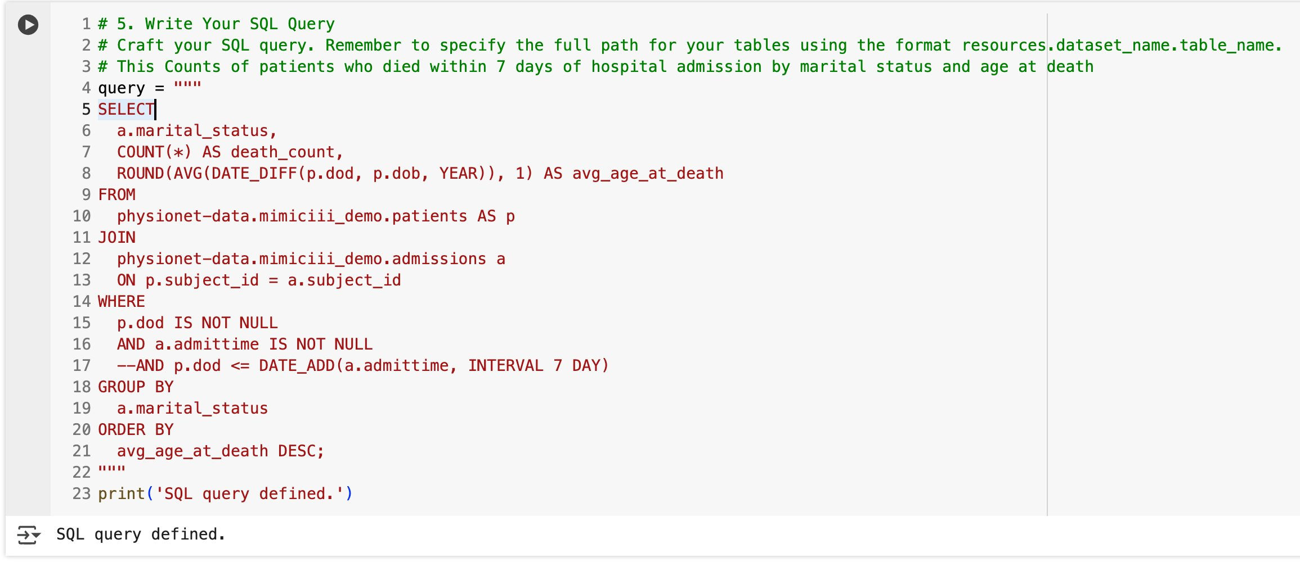
Mortality Counts and Average Age at Death by Marital Status
Goal:
To determine the number of deceased patients and their average age at death, grouped by marital status.
Implementation:
Joins patients and admissions tables on subject_id.
Filters for patients with a non-null date of death (p.dod) and non-null admission time.
Calculates:
death_count: Number of deaths per marital status.
avg_age_at_death: Average age at death, in years, rounded to 1 decimal.
Results are grouped by marital status and ordered by average age at death (descending).

Slide 10
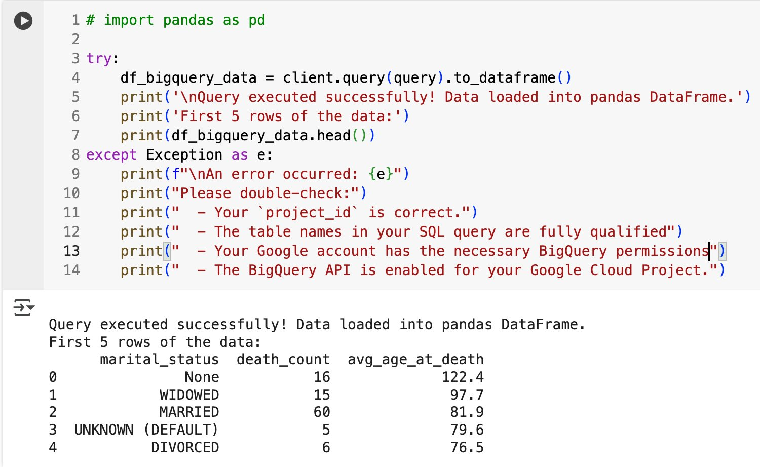
Outcome & Interpretation
Interpretations:
Implausible Ages: The group with marital_status = None has an average age at death of 122.4 years, which is biologically implausible and suggests data entry or calculation errors (e.g., missing or incorrect dates of birth/death).
Widowed: High average age at death (97.7), which is plausible given demographic trends.
Married: Largest group (60 deaths), average age at death 81.9.
Unknown/Default/None: These categories indicate incomplete or improperly coded marital status.
Divorced: Lowest average age at death among these groups (76.5).
Recommendations:
The results are affected by data quality issues and the lack of a time-to-death filter. Data cleaning is recommended for more accurate insights.
The presence of implausible ages and ambiguous marital status categories (None, UNKNOWN (DEFAULT)) indicates a need for data cleaning.
The filter for deaths within 7 days of admission is commented out. As written, the query includes all deaths, not just those soon after admission.
Clean data by removing implausible ages (e.g., age <0 or >110).
Standardize or exclude ambiguous marital status.
We can analyze early mortality, uncomment and use the 7-day filter.

Slide 11
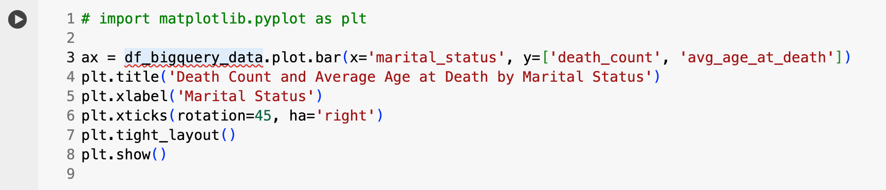
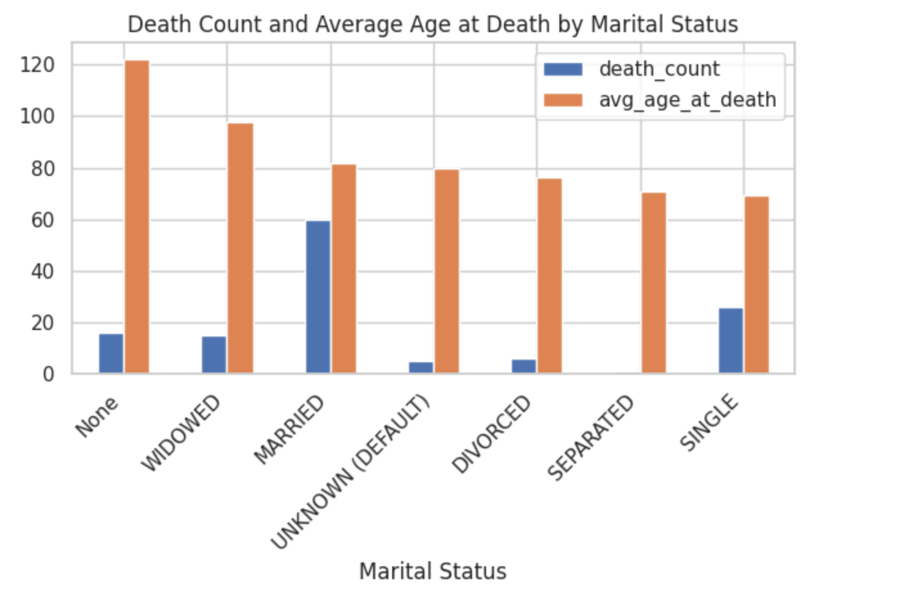
Death Count by Marital Status (Bar Plot)
Goal:
Visualize the query results using a bar chart in pandas and matplotlib, which is ideal for comparing categorical data such as marital status against death counts or average age at death.
Obtain The Data: We have successfully queried the data from Google BigQuery into a pandas DataFrame named df_bigquery_data.
Run the Plotting Code: Once you have your df_bigquery_data DataFrame ready, execute the provided Python code in your environment (e.g., a Jupyter Notebook or Google Colab cell).
Interpret the Plot: After running the code, a bar chart will be displayed. This chart visually represents the death_count and avg_age_at_death for each category of marital_status, allowing for quick comparison and analysis of these metrics across different marital groups.
Conclusion: This result provides a summary of mortality counts and average age at death by marital status, but the results are affected by data quality issues and the lack of a time-to-death filter. Data cleaning is required for more accurate insights. We can perform this cleaning two ways:
1. with SQL filter or
2. Clean in Pandas after loading

Slide 12
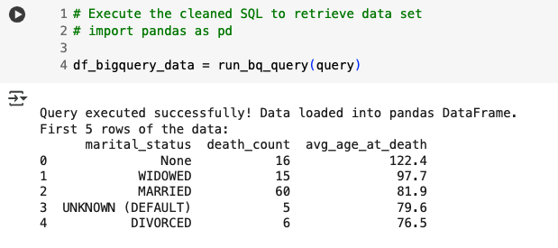
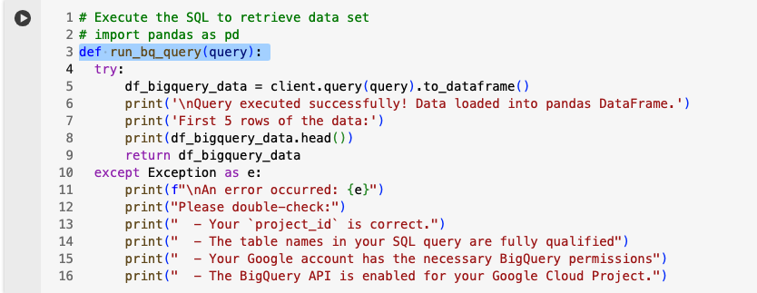
Define BigQuery Helper Function
Goal:
Now we take the opportunity to improvise our client query to avoid writing redundant code and convert it to a Helper function.

Slide 13
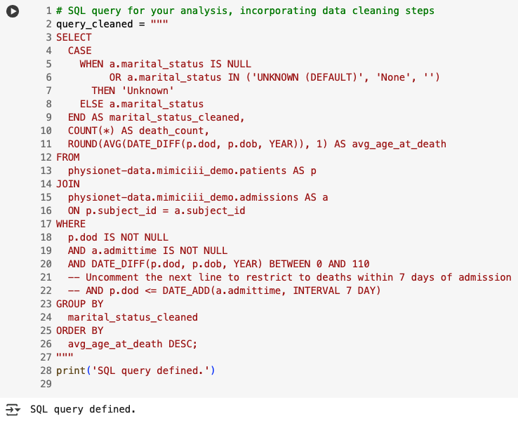
Data Cleansing with SQL: This SQL query is incorporating data cleaning steps for analysis

Slide 14
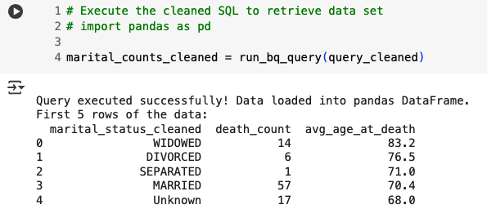
Cleaned Query Results & Interpretations:
Married individuals have the highest death count, but they also tend to die at a younger average age (~70) compared to widowed and divorced individuals. This could be due to a higher representation of married individuals in the overall dataset, and not necessarily poorer health outcomes.
Widowed individuals show a lower death count but the highest average age at death (~83). This indicates longer life expectancy, potentially due to prior long-term companionship or spousal care before widowhood.
Divorced and separated individuals fall in between - fewer deaths but also lower average age at death than the widowed. May suggest reduced social support after separation, affecting long-term health outcomes.
Single individuals (from the extended version of the dataset you plotted) show lower life expectancy (~60) with a relatively high number of deaths, supporting the hypothesis that lack of companionship may contribute to poorer outcomes.
Unknown marital status also skews younger, but is hard to interpret definitively due to lack of context.

Slide 15
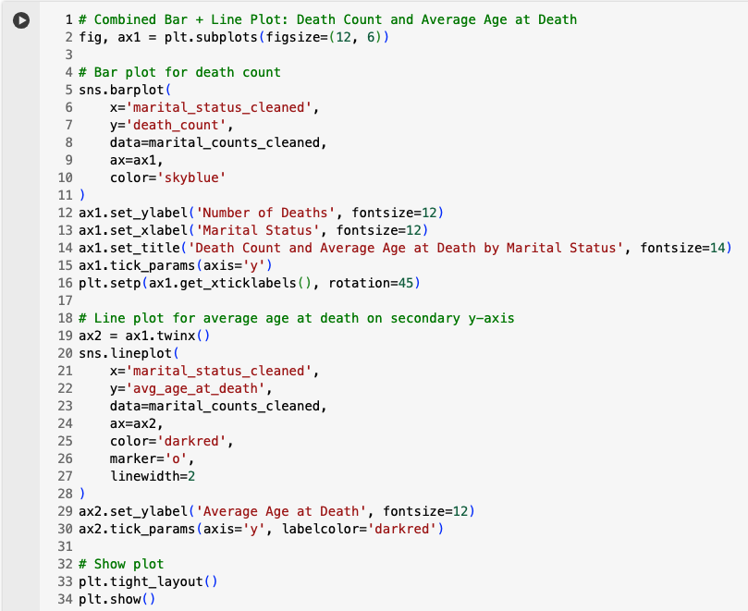
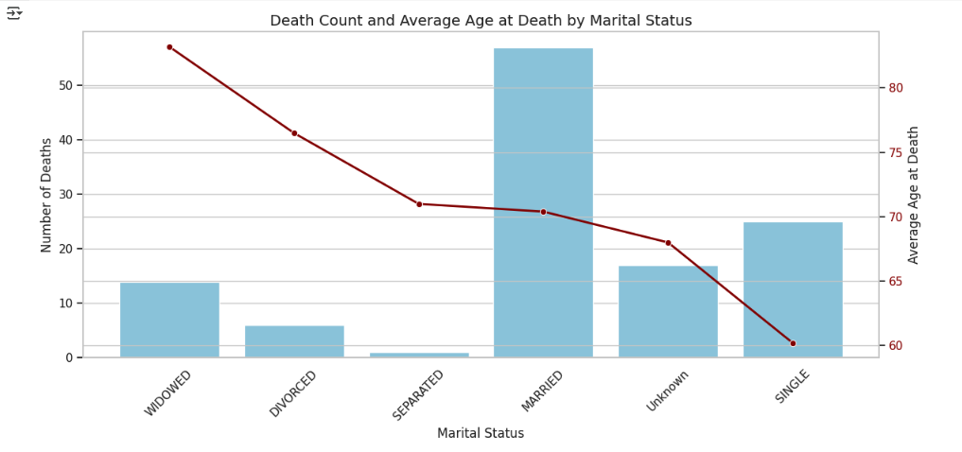
Combined Visualization of Death Count and Average Age at Death by Marital Status
Create a figure and primary axis: Set the canvas size to ensure clear display.
Draw the bar plot : Use the primary axis to plot the number of deaths per marital status. Apply a consistent color for clarity (Sky blue). Add axis labels and a title. Rotate x-axis labels for readability.
Create a secondary y-axis: Mirror the x-axis but allow for a different y-scale. This axis s used to plot average age at death.
Overlay the line plot: Use the secondary axis to draw a line graph of average age at death. Add data markers for each marital status. Use a distinct color (dark red) to differentiate from the bar plot.
Label the secondary axis: Add appropriate y-axis label and match it to the line color.
Finalize the layout : Apply tight layout to avoid overlaps. Display the combined chart.

Slide 16
Restrict to deaths within 7 days of admission to check early mortality after admission

Slide 17
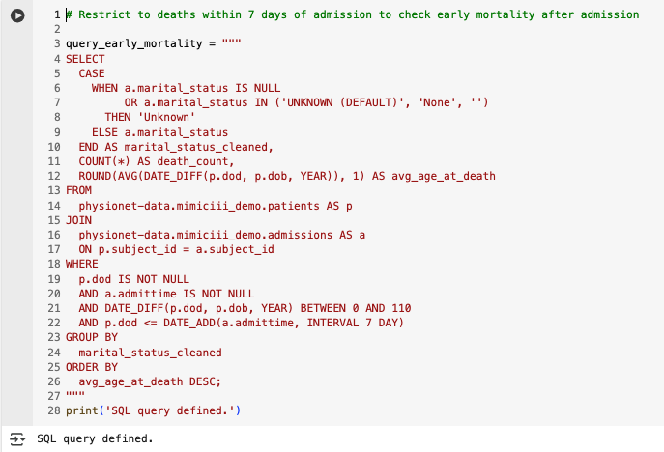
Mortality Counts and Average Age at Death by Marital Status within 7 days of admission
Goal:
To determine the number of deceased patients and their average age at death, grouped by marital status.
Implementation:
Joins patients and admissions tables on subject_id.
Filters for patients with a non-null date of death (p.dod) and non-null admission time.
Calculates:
death_count: Number of deaths per marital status.
avg_age_at_death: Average age at death, in years, rounded to 1 decimal.
This time Restrict to deaths within 7 days of admission to check early mortality after admission
Results are grouped by marital status and ordered by average age at death (descending).

Slide 18
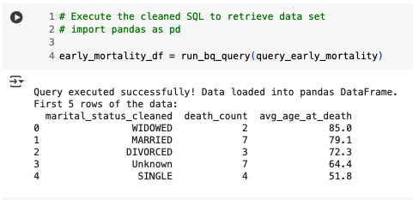
Outcome & Interpretation
Interpretations:
WIDOWED patients, although few in count, had the highest average age at early death, potentially due to limited social support post-loss of spouse.
MARRIED patients had relatively more early deaths (7) but at a higher average age (79.1), suggesting supportive companionship may extend life even in acute cases.
SINGLE individuals had lower average age at death (51.8)—a striking indicator that lack of support correlates with younger mortality.
Unknown marital status shows a comparable death count to married (7) but much lower age at death, which may indicate either missing documentation or neglected social support tracking.
Recommendations:
Explore Further Stratification by Breaking down these stats by ICU type, gender, or comorbidity index.
NLP Follow-Up to use unstructured clinical notes to detect loneliness, depression, or caregiver presence.

Slide 19
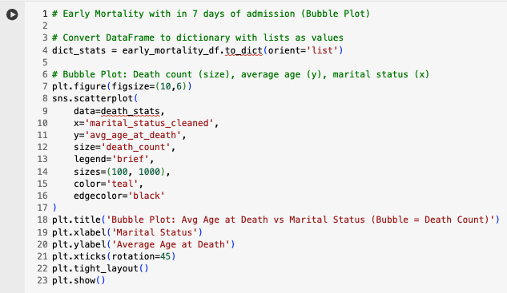
Early Mortality with in 7 days of admission (Bubble Plot)
Goal:
Visualize early mortality within 7 days of admission by marital status using a bubble plot, where the x-axis represents marital status, the y-axis shows average age at death, and bubble size encodes the number of deaths. This enables clear, multi-dimensional comparison of early mortality patterns across social relationship groups.
Code Implementation:
Convert DataFrame early_mortality_df to a dictionary with columns as keys and lists of column values as values, using the to_dict method with the 'list' orientation.
Set up your plot area with a suitable figure size.
Use Seaborn’s scatterplot function to create a bubble plot:
Set the x-axis to marital status.
Set the y-axis to average age at death.
Set the bubble size proportional to the death count.
Customize the appearance with color, edge color, and legend.
Add a title and axis labels, rotate the x-axis labels for readability, and use tight layout to prevent overlap.
Display the plot.
This workflow will visually encode three variables—marital status, average age at death, and death count—into a single, interpretable bubble plot.

Slide 20
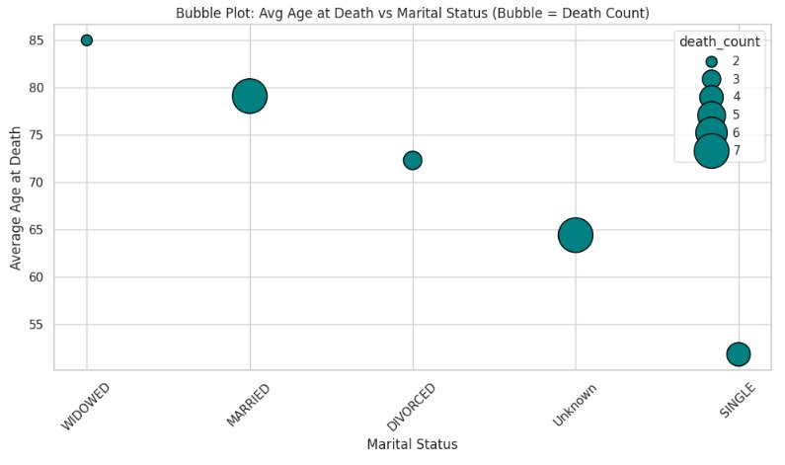
Visualization:
Conclusions:​
Married individuals likely benefit from stronger social and emotional support, which may delay mortality even during early critical illness. Those listed as single or divorced/separated often showed earlier average age of death—possibly due to loneliness, stress, or poor health adherence. Widowed Group: Though older (expected), their mortality can reflect loss of companionship impact.

Slide 21
Load files form Google Drive

Slide 22
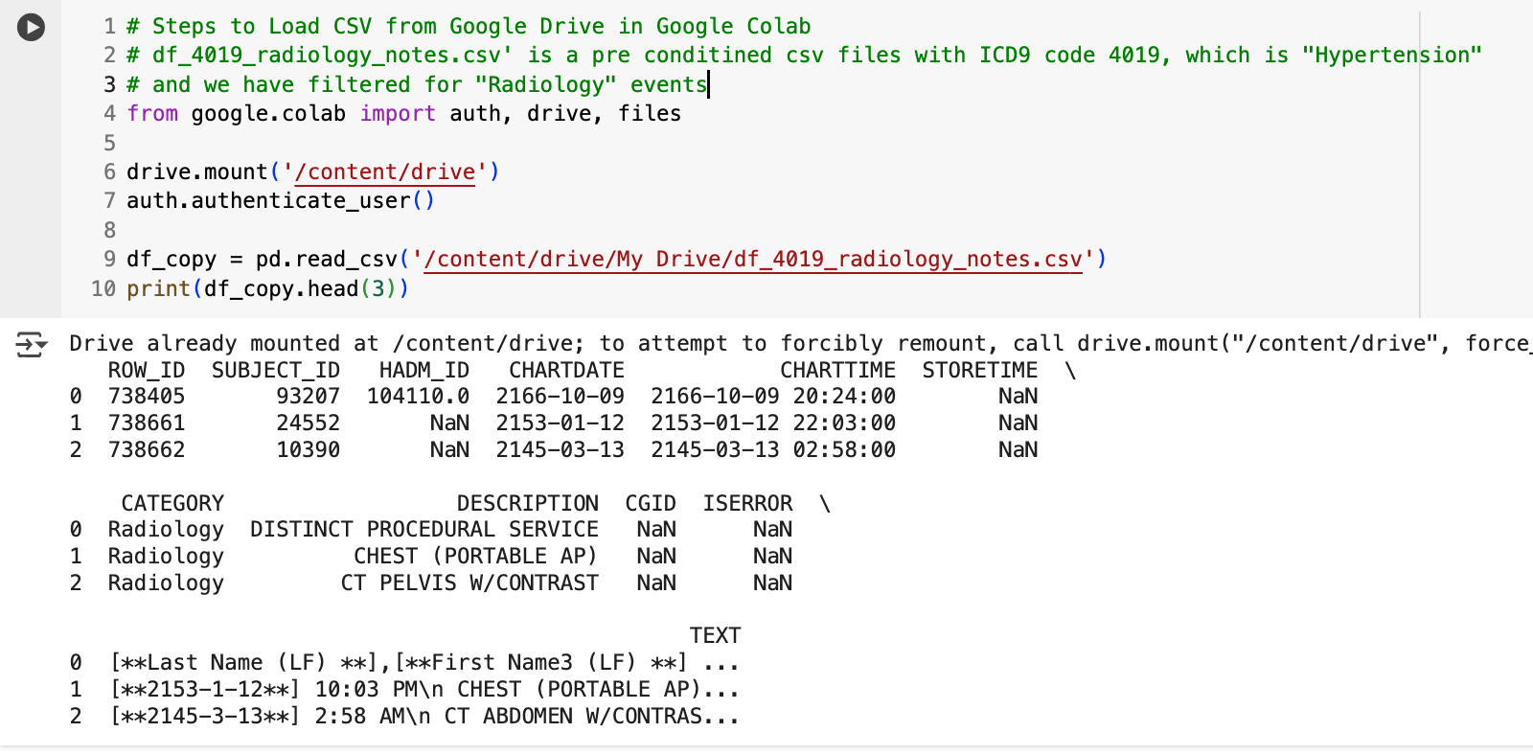
df_4019_radiology_notes.csv is a pre-filtered CSV file containing records with the ICD-9 code 4019 (Hypertension), specifically filtered for Radiology events. The source of this data is the NOTEEVENTS table from the MIMIC-III database.

Slide 23

Steps to Load a CSV from Google Drive in Google Colab
Import necessary libraries for Google Drive access and authentication.
Mount your Google Drive to the Colab environment so files can be accessed like a local filesystem.
Authenticate access when prompted by following the authorization URL and entering the code.
Locate the full path to the CSV file in your Google Drive (e.g., inside "My Drive").
Read the CSV file into a pandas DataFrame using the full file path.
Verify the data by displaying the first few rows of the DataFrame.

Slide 24
Clean and Tokenize

Slide 25
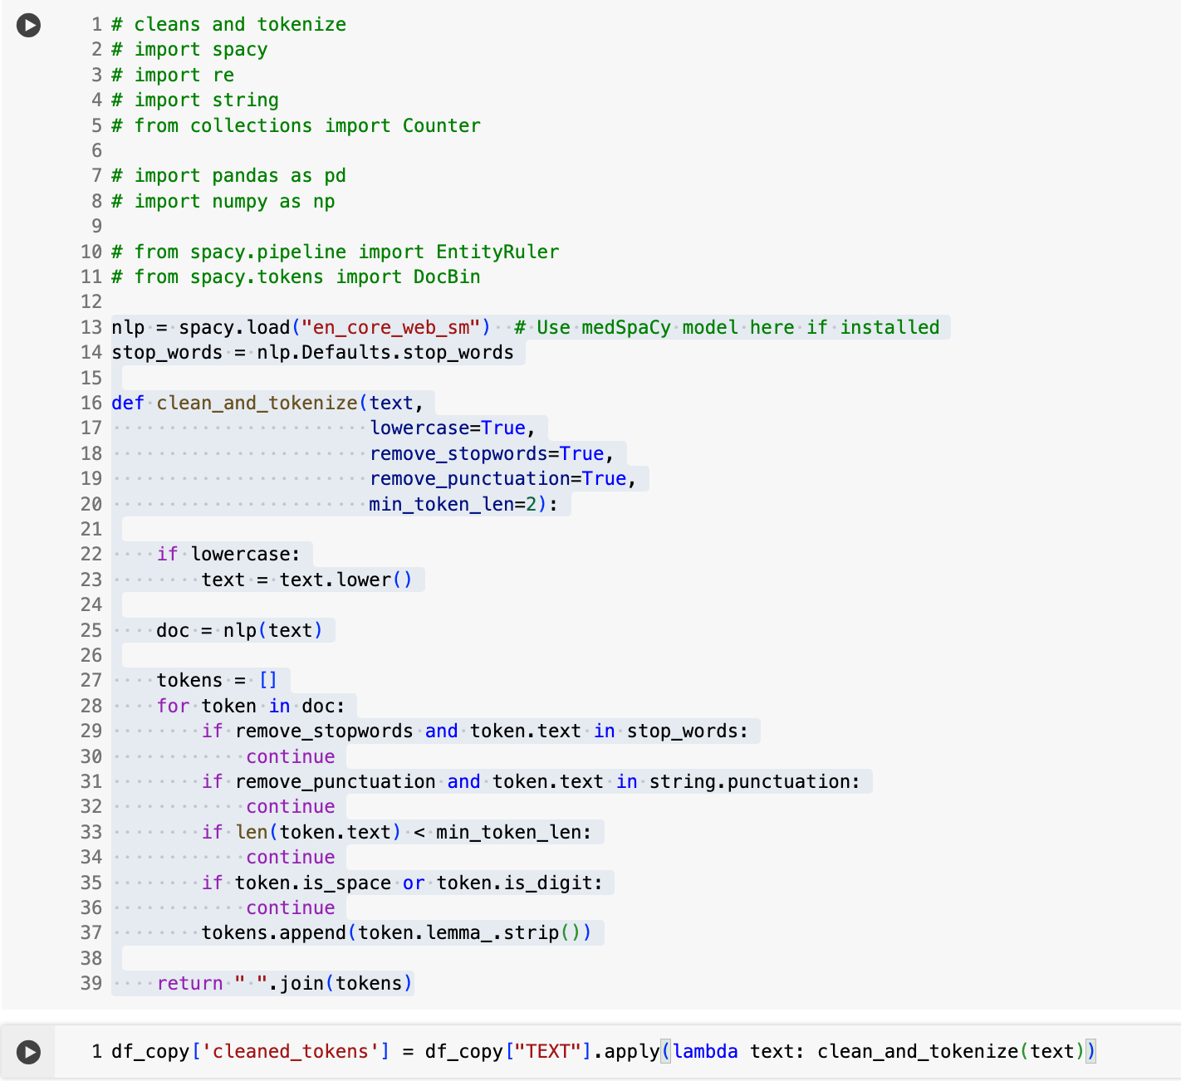
Clean and Tokenize Texts
Library Imports (Lines 1–13)
Imports essential NLP and data processing libraries like spacy, re, string, and Counter. pandas and numpy are included for dataframe operations and numerical tasks. Some optional SpaCy components (EntityRuler, DocBin) are commented out but can be used for advanced customization.
Loading SpaCy Language Model (Line 13)
Loads the en_core_web_sm model for English NLP tasks.
You can replace this with a more medically tuned model like medSpaCy if available.
Stop Words Setup (Line 14)
Retrieves default English stop words (e.g., “the,” “is,” “in”) from SpaCy for later filtering.
Token Cleaning Function: clean_and_tokenize This custom function processes raw text through several steps
Lowercase (Line 22) – Converts all text to lowercase (if enabled).
SpaCy Tokenization (Line 24) Breaks text into SpaCy Token objects.
Filtering Loop (Lines 27–36) Removes stop words, punctuation, very short tokens (e.g., length < 2), digits, and spaces. Only keeps the lemma (base form) of each remaining token, with whitespace stripped.
Join Clean Tokens (Line 39) – Converts the cleaned list of tokens back to a single string.
Apply Cleaning to DataFrame Column (Line 41)
Applies the clean_and_tokenize() function to each row in the TEXT column of df_copy. Stores the output in a new column named 'cleaned_tokens'

Slide 26

Benefits of This Approach
Tokenization with SpaCy This uses a powerful natural language processing engine that understands the structure of language. It breaks down text into tokens, identifies their lemmas (base forms), and can recognize parts of speech and named entities.
Lowercasing & Stopword Removal Converting text to lowercase ensures consistency, and removing common stop words (like “the,” “is,” “and”) reduces noise in the data. This helps in improving the clarity of models and visualizations.
Lemmatization Lemmatizing words reduces them to their root forms—for example, “running” becomes “run.” This helps in grouping similar words together and provides more meaningful insights during analysis.
Punctuation & Digit Removal Removing punctuation and numbers strips out irrelevant characters that don’t contribute to the semantic meaning of the text.
Minimum Token Length Filtering This step helps eliminate short, often meaningless fragments (like “a” or “x”) which are not useful in text analysis.
Result: Cleaned Text The final output is a cleaned, structured version of the original text. This dramatically improves the quality and accuracy of downstream tasks such as keyword extraction, topic modeling, and word embeddings.

Slide 27
Named Entity Recognition (NER)

Slide 28
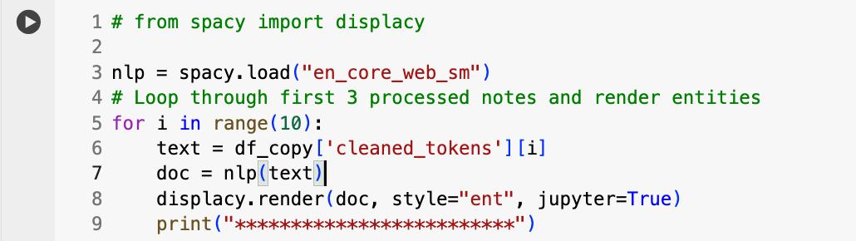
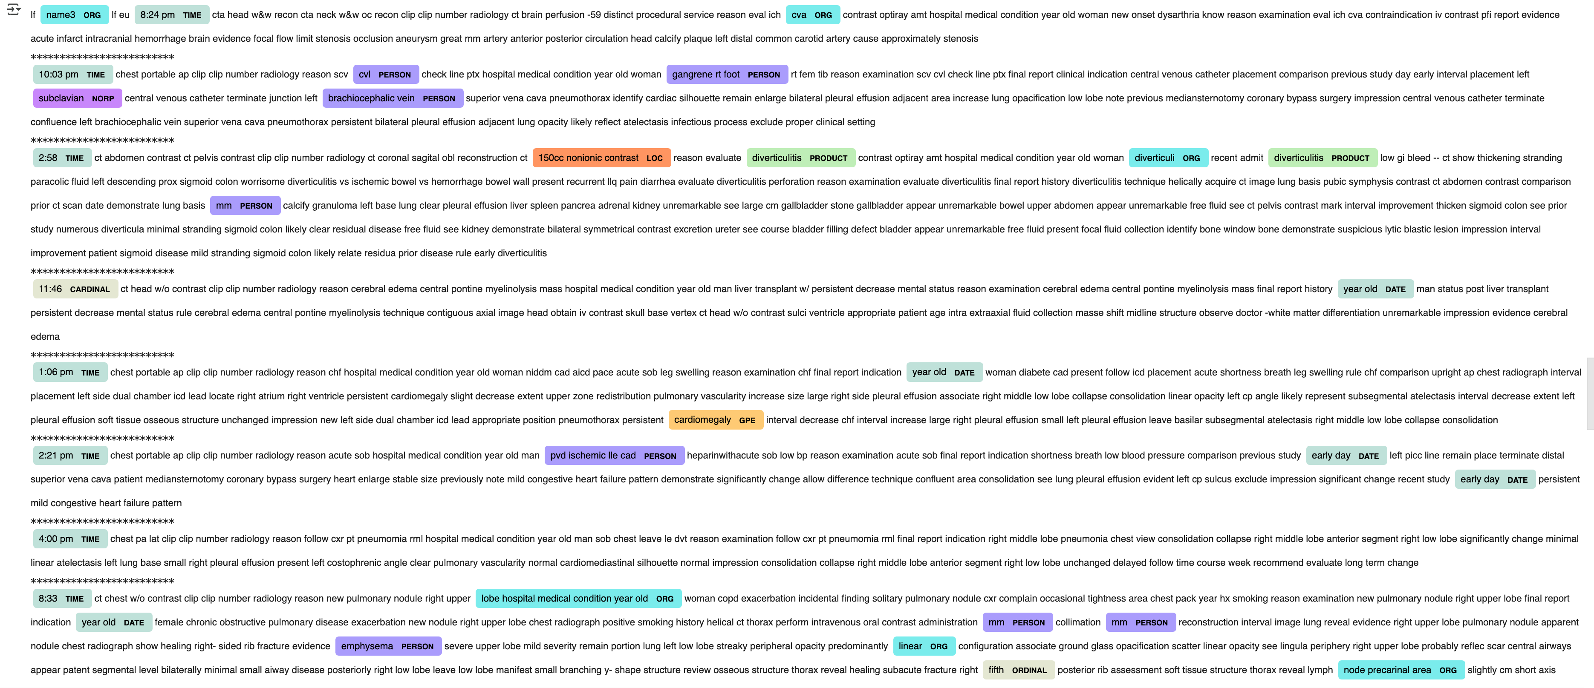
NER helps you quickly inspect in recognizing and labeling entities in your notes, and visually highlights them for manual review or further analysis

Slide 29
Code walkthrough and Utility of NER
This code uses spaCy and its visualization tool displaCy to process and visually inspect named entities in clinical or textual notes. Here’s a step-by-step explanation:
Model Loading: nlp = spacy.load("en_core_web_sm") Loads the small English language model, which includes a pre-trained named entity recognizer (NER).
Iterate Through Notes: The for loop goes through the first 10 entries (i in range(10)) in the DataFrame column cleaned_tokens, which is assumed to contain preprocessed text notes.
Process Text: For each note, doc = nlp(text) processes the text with the spaCy pipeline, including tokenization, tagging, and NER.
Visualize Entities: displacy.render(doc, style="ent", jupyter=True) Uses displaCy to highlight and label any named entities detected in the text (such as PERSON, DATE, ORG, etc.) directly in a Jupyter notebook cell.
The style="ent" argument specifies that named entities should be visualized.
The jupyter=True flag ensures the visualization appears inline in Jupyter notebooks.
Separator: print("****") Prints a line of asterisks to visually separate the output for each note.
Benefits of NER (Named Entity Recognition):
Extracts key info from unstructured text (e.g., names, dates, places).
Saves time by automating data tagging and classification.
Enables analysis like trend detection, summarization, and search.
Improves decision-making with structured insights from raw text.
Supports automation in healthcare, finance, legal, and more.

Slide 30
Most Common Diagnoses by Marital Status in MIMIC-III Admissions

Slide 31
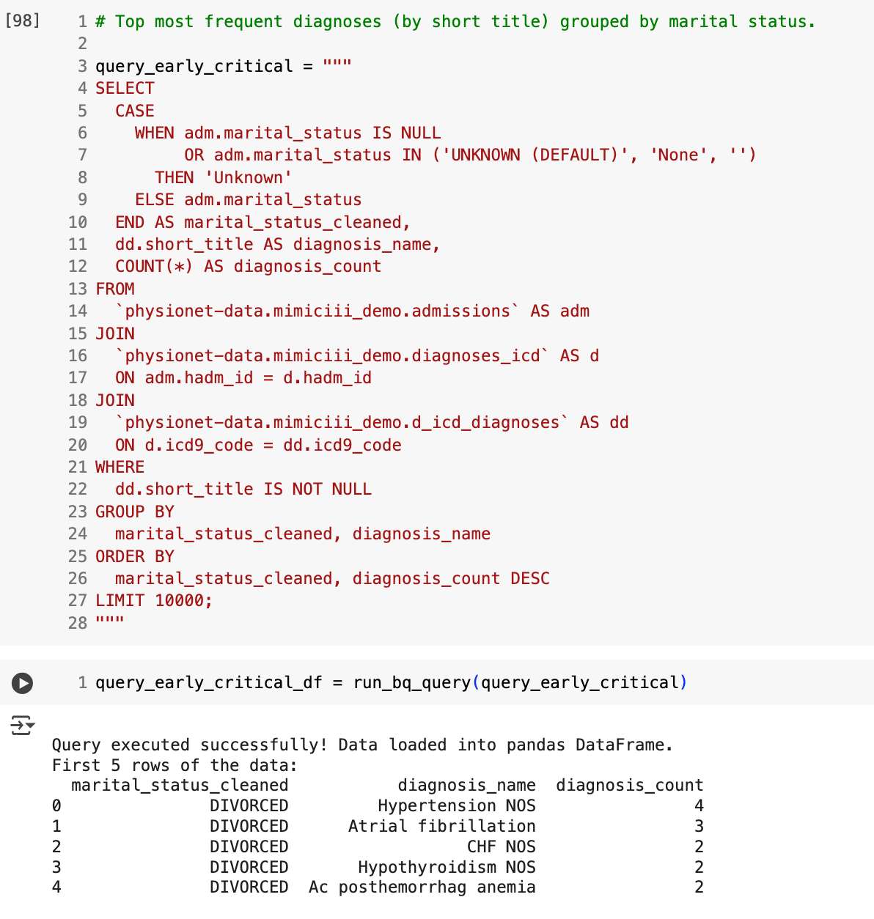
This process identifies the most frequently occurring medical diagnoses across different marital status categories in the MIMIC-III dataset. It helps examine potential health trends linked to social support. We get a detailed profile of which illnesses are most common for married, divorced, widowed, single, and unknown-status patients - providing insight into how social factors might influence disease burden.
Standardize Marital Status: Marital statuses like "UNKNOWN", "None", or empty values are grouped under a single label, "Unknown", to ensure consistent categorization.
Gather Diagnoses: Diagnoses for each patient are extracted using short, human-readable labels that describe the condition (like: “Hypertension”).
Join Relevant Tables: Combines data from admissions, diagnosis events, and diagnosis dictionary to map each hospital stay to a diagnosis and corresponding marital status.
Count Frequencies: Calculates how many times each diagnosis occurs within each marital status group.
Group and Rank: Organizes the data by marital status and ranks diagnoses from most to least frequent.
Filter Out Invalid Data: Any diagnosis without a proper title is excluded to maintain clean and interpretable results.
Limit Output:
Keeps the results manageable by returning only the top 10,000 records.

Slide 32
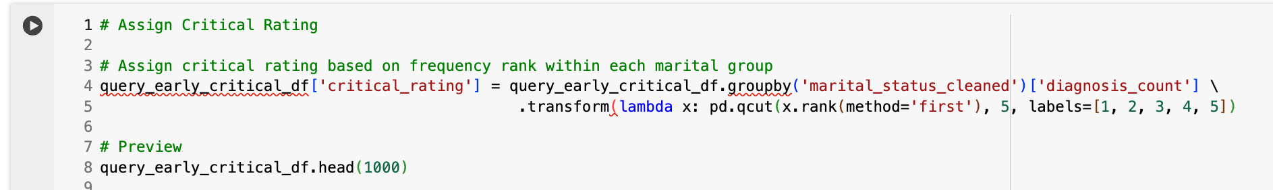
From Raw Counts to Risk Scores: Ranking Diagnoses Smarter
Identifies Group-Specific Risks: Flags the most urgent diagnoses within eachmarital status group.
lags the most urgent diagnoses within eachmarital status group.
Simplifies Visualization: Enables easy color-coding or ranking in charts anddashboards.
Aids Prioritization: Highlights top-rated (5) conditions for focused clinical attention.
Ensures Fair Comparison: Normalizes across groups, avoiding bias from group sizeor volume.
Supports Risk Modeling: Useful as input for predictive analytics and health riskscoring.
Group by
Group by Marital Status: The data is first separated into groups based on each patient's marital status (e.g., Married, Divorced, Widowed, etc.).
Rank
Rank Diagnoses by Frequency: Within each marital group, diagnoses are ranked based on how frequently they appear. The most common diagnosis in that group gets the highest rank.
Divide
Divide into Buckets (Quantiles): These ranked diagnoses are split into five equal-sized groups (quintiles). Each group represents a different level of criticality based on how common the diagnosis is.
Assign
Assign a Critical Rating (1 to 5): A numeric rating is assigned:
5 for most critical/common diagnoses (top 20%),
1 for least frequent/critical (bottom 20%).
Attach
Attach Rating to Each Record:
The new rating is added as a column to the dataset, so each diagnosis now carries a “criticality score” to its marital status group.

Slide 33
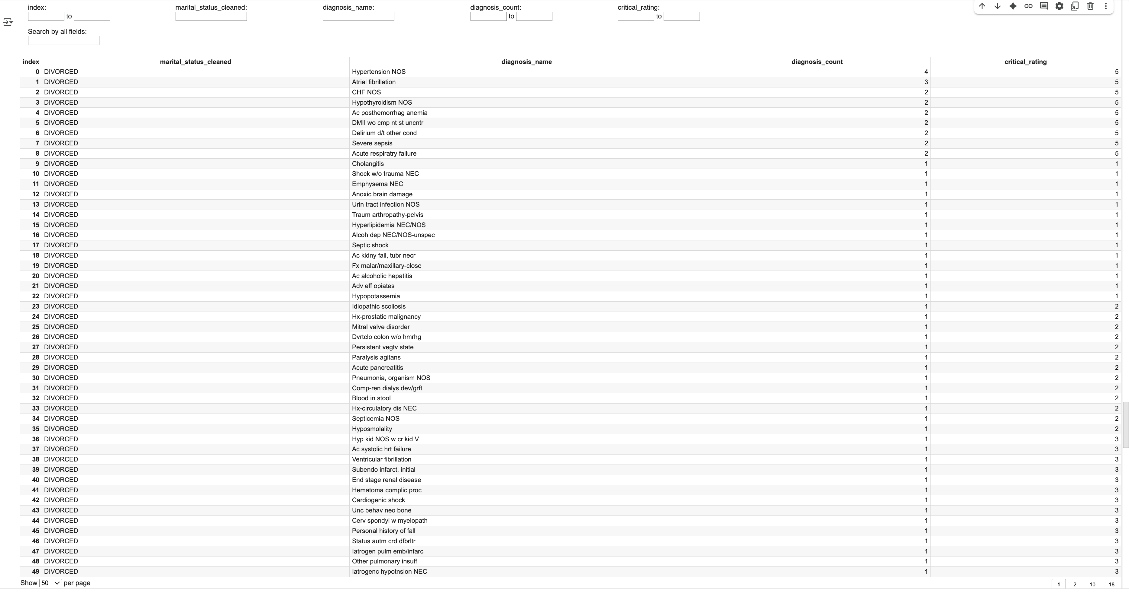
Assign critical rating based on frequency rank within each marital group

Slide 34
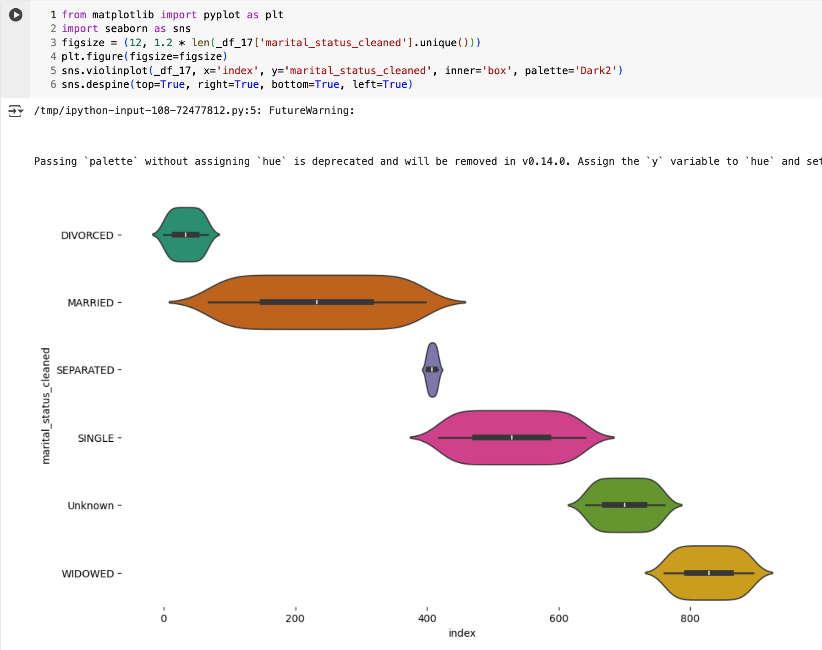
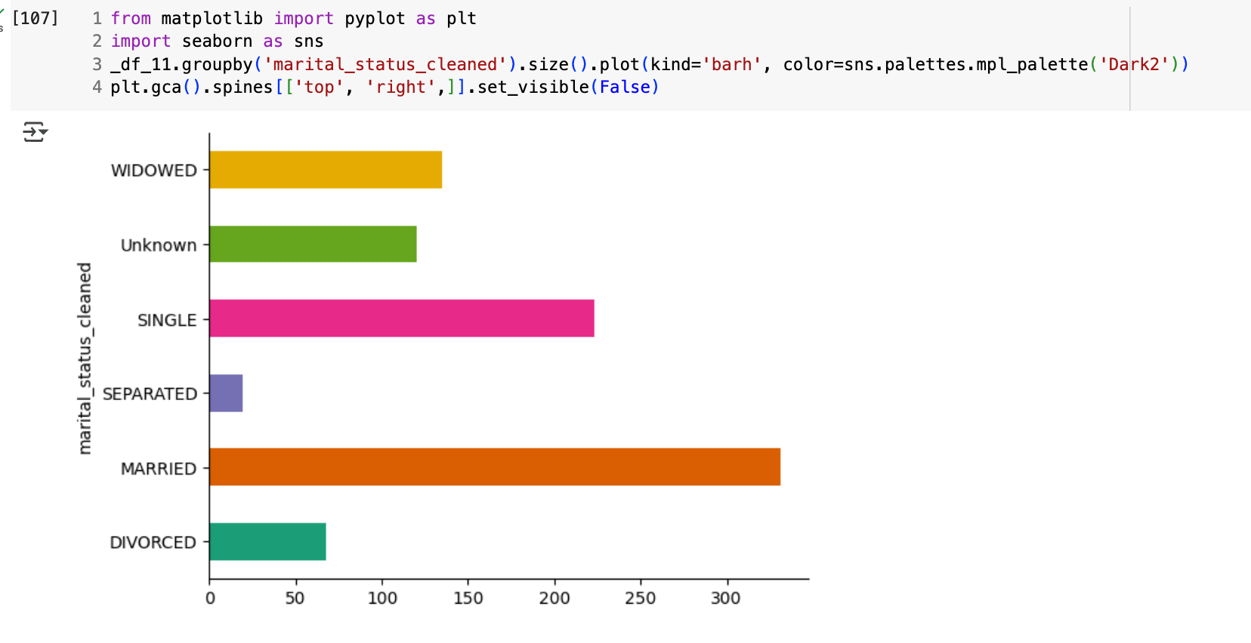
Uncovering Hidden Health Patterns with Criticality Scores

Slide 35
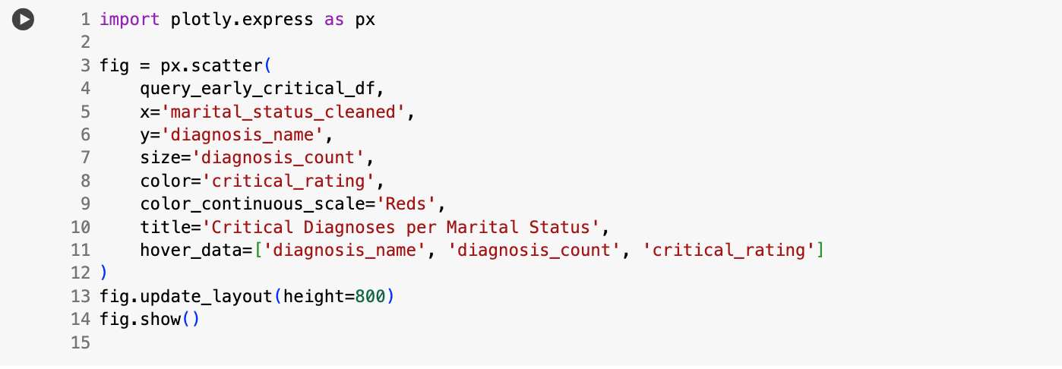
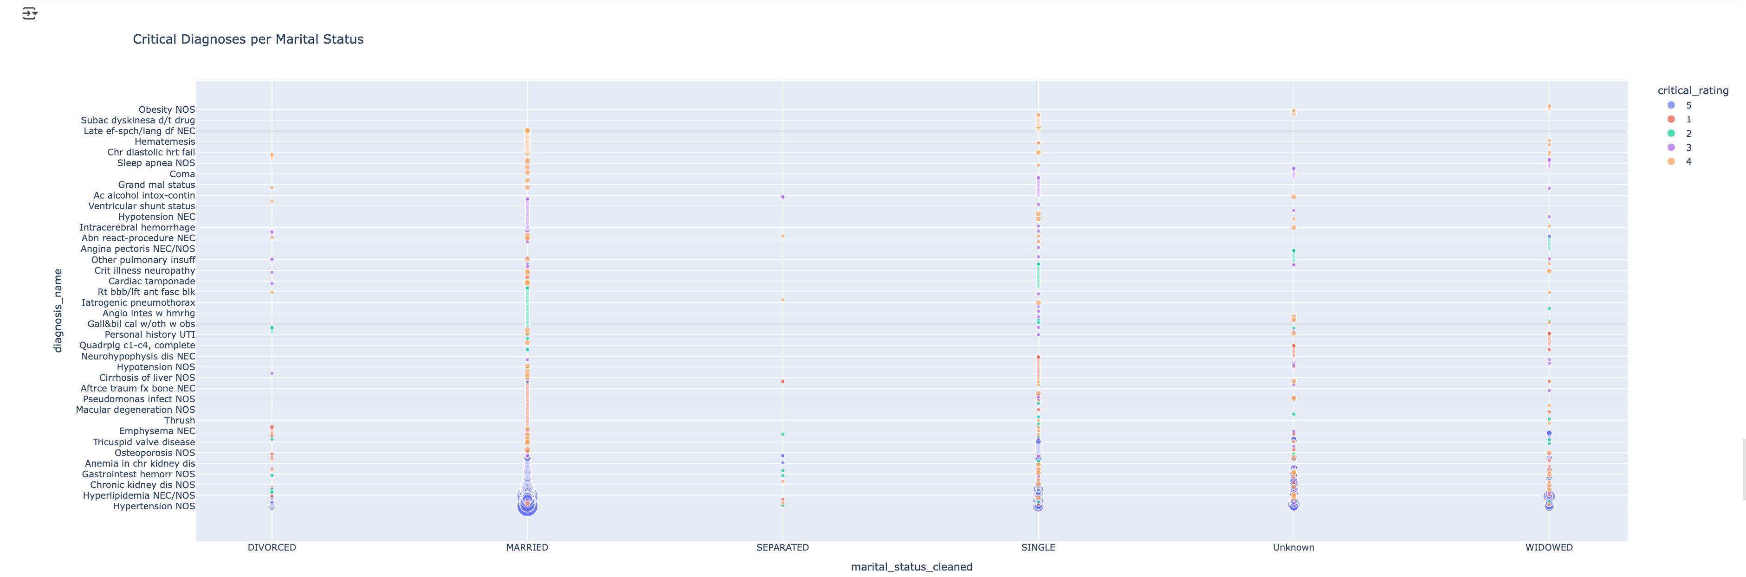
Intuitive, Interactive Insight into Critical Diagnoses Across Marital Status Groups

Slide 36

Benefits of This Visualization Approach
Highlights Group-Specific Health Risks: You can easily compare which diagnoses are most common and critical among different marital statuses.
Size and Color Encode Multiple Data Dimensions: Using both bubble size and color allows quick understanding of two variables (count and criticality) simultaneously without clutter.
Interactive Exploration: Hover details provide granular data without overwhelming the visual, making it suitable for presentations or clinical reviews.
Facilitates Prioritization: Identifying which diagnoses have the highest critical rating and frequency can help prioritize healthcare interventions or further analysis.
Clear Visual Segmentation: The categorical x-axis groups patients logically, making patterns and disparities easy to spot.
Customizable and Scalable: Plotly’s interactive features allow zooming, panning, and easy modification, adapting well for dashboards or reports.

Slide 37
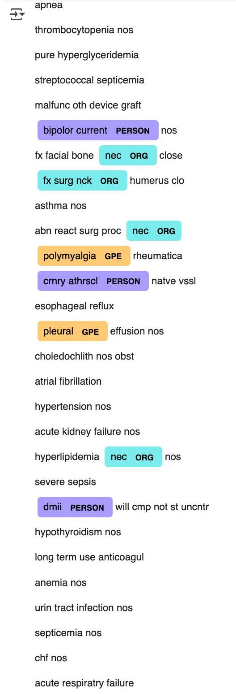
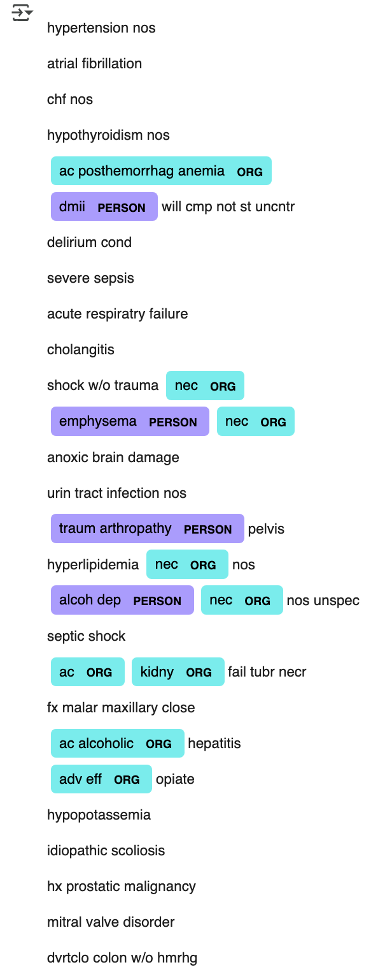
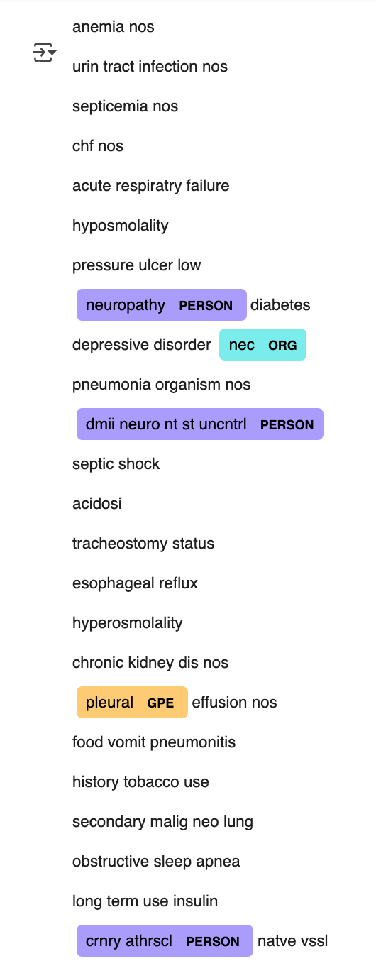
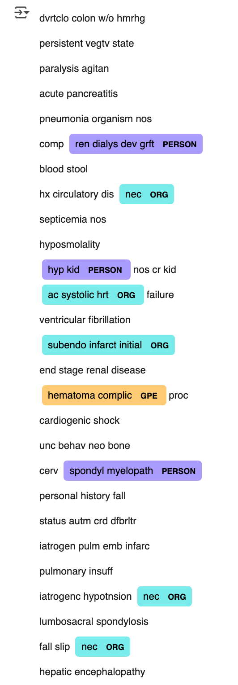
Leveraging NLP to Extract and Visualize Medical Entities from Diagnoses

Slide 38
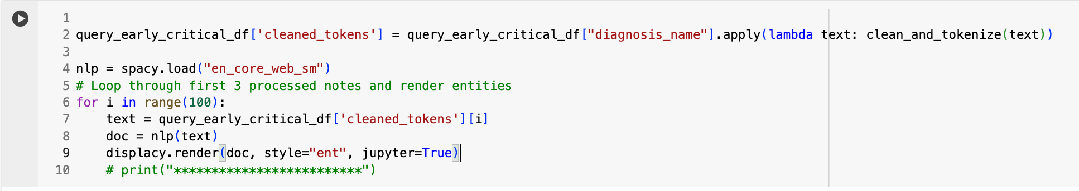
Named Entity Recognition (NER) on Clinical Diagnoses Using spaCy
Code Walkthrough:
Text Cleaning and Tokenization: The code applies a custom clean_and_tokenize function to the "diagnosis_name" column of the DataFrame, creating a new column "cleaned_tokens" containing the processed text.
Load spaCy Model: Loads the pre-trained English language model (en_core_web_sm) to enable NLP tasks including Named Entity Recognition (NER).
Entity Extraction and Visualization: Iterates over the first 100 cleaned diagnosis texts. For each, it:
Processes the text with spaCy to generate a Doc object containing linguistic annotations.
Uses displacy.render to visually highlight and label any named entities (such as diseases, drugs, or other biomedical terms) found in the text, directly in a Jupyter notebook cell for easy inspection.

Slide 39

Benefits of spaCy Modeling Approach
Transforms Unstructured Text into Structured Data: Converts raw diagnosis text into tokenized and labeled components that computers can work with efficiently.
Highlights Clinically Relevant Information: Automatically identifies and visualizes important medical entities, facilitating better understanding of diagnoses.
Supports Data Exploration and Quality Checks: Visualizing entities helps spot inconsistencies or errors in the data early on.
Enables Downstream Analytics: Structured entities can be used in predictive models, clustering, or further natural language processing tasks.
Improves Interpretability: Makes complex clinical notes accessible for clinicians, researchers, or data scientists through clear visualization.
Scalable to Large Datasets: Automates entity recognition on many records, saving manual review time and effort.

Slide 40
The Unseen Role of Social Support: Marital Status and Healthcare Outcomes
While clinical factors are vital in healthcare outcomes, analysis of the MIMIC III dataset reveals that social determinants, especially marital status, play a crucial yet often overlooked role in patient health trajectories.
Research shows that married individuals tend to have better outcomes. This advantage is linked to stronger support systems that promote treatment adherence, provide emotional and practical help, and encourage earlier medical intervention. Such support can improve recovery rates and reduce mortality risk.
Our MIMIC III analysis highlights the vulnerability of single or isolated patients. Without immediate social support, these individuals may delay seeking care, face emotional challenges during health crises, and encounter higher risks of complications or death, particularly after major events like surgery.
Marital status acts as a proxy for broader social support networks in health research. When combined with age at death, it offers deeper insights. For example, a younger average age at death among single patients suggests an urgent need for targeted support and intervention. Conversely, older age at death may reflect natural disease progression, but social support remains a critical factor.
This study emphasizes that clinical data alone cannot capture the full picture. Ignoring social factors like marital status risks missing key influences on patient outcomes. Future research should integrate social determinants more systematically, improve data quality by addressing missing or null marital statuses, and adjust for variables like age, gender, illness severity, and comorbidities. Only then can we fully understand the complex interplay of clinical and social factors shaping health outcomes in datasets like MIMIC III.

Slide 41


https://mermaid.live/
https://colab.research.google.com/drive/1l_tOX2wXK8LuZqxmPWaWfBJmlc6wmZdE?usp=sharing
SLT- Social support in HealthCare.pptx

